Slide 1









Sylvie
Aitken
Communications Director, Plastics Europe
Virginia
Janssens
Managing Director, Plastics Europe
Dr. Katharina Schlegel Thummer
Circularity Director, Plastics Europe
Press Conference
Plastics the Fast Facts 2025:
Our industry in numbers
13:00 – 14:00 CET
Notes:
This slide will be on display while people arrive and settle in.
Notes: VJ and KS to be on stage before the press conference begins.

Slide 2
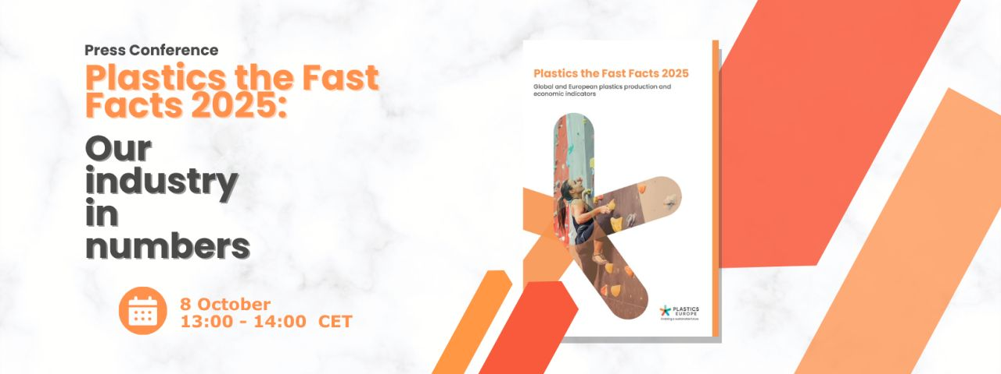
Welcome - official launch of
Plastics the Fast Facts 2025
Notes:
[Sylvie to introduce the session & report]
Good afternoon, everyone, and welcome.
I’m Sylvie Aitken, Communications Director at Plastics Europe, and I will be your moderator for the official launch of Plastics the Fast Facts 2025.
A warm welcome also to those joining online on YouTube and LinkedIn Live– great to have you with us.
For those of you who are new to our data reports:
Plastics the Fast Facts is our annual benchmark publication
It presents preliminary global and European plastics production data and trends for 2024
Figures we’ll unveil shortly.

Slide 3
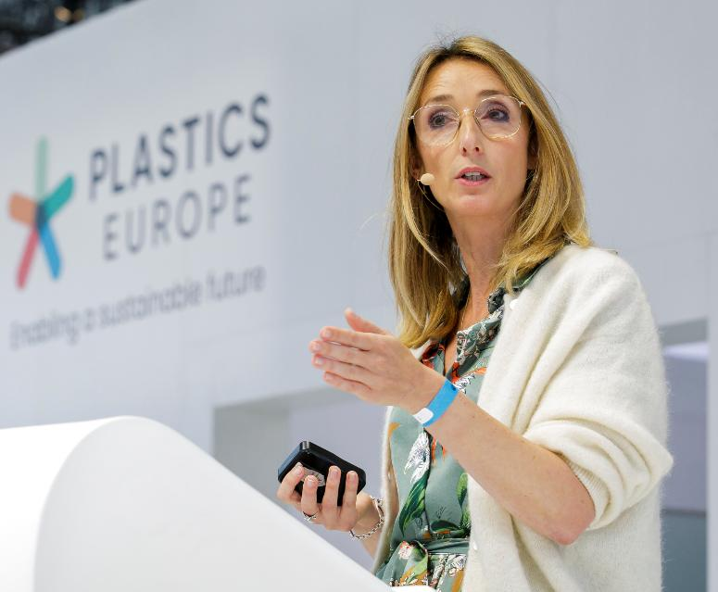

VIRGINIA JANSSENS,
Managing Director, Plastics Europe
Dr. KATHARINA SCHLEGEL THUMMER,​
Circularity Director, Plastics Europe
Notes:
Sylvie:
Let me now introduce our speakers for today.
We’re joined by Virginia Janssens, Managing Director of Plastics Europe, who will set the tone with reflections on the state of our industry, its outlook, and calls to action.
And Dr. Katharina Schlegel Thummer, our Circularity Director, who will take us through the data and trends shaping this year’s findings.
And with that, Virginia, the floor is yours.
………………………………………………………………………………………..
Virginia
Thank you, Sylvie.
And a warm welcome to everyone. Thank you for joining our press conference to launch our Plastics the Fast Facts 2025.

Slide 4






An industry under pressure, but committed to Europe’s transition
Global production
EU27+3 production
EU indicators & trade
GROWTH
STAGNATION
DECREASE
Notes:
As Managing Director of Plastics Europe, I stand before you representing an industry responsible for 90% of the polymer production in Europe.
A sector that is essential to Europe’s competitiveness, supplying automotive, renewables, batteries, healthcare, packaging, the list is extensive.
But more than that - we are a critical player in Europe’s transition to a circular and climate-neutral economy.
I also speak on behalf of an industry in Europe under pressure.
Let us be clear: we are facing tough times.
Before I hand over to my colleague Katharina who will present our data in more detail, I would like to highlight some key figures to set the tone.
Europe’s global market share has collapsed from 22% in 2006 to only 12% in 2024.
This contrasts starkly with global plastics production, which increased 4.1% last year, with Asia producing 57.2% of the world’s plastics.
In addition to that, our circular plastics production in Europe is stagnating, with total production of just 8.4 million tonnes, about 15.4% of total production in Europe.
And all this - reflected by a sharp decline in turnover over the last two years,
and ongoing announcements of business closures and job losses.
So, what does this mean for the industry?
Europe’s past leadership in circular plastics is now being eclipsed by other regions.
We are at risk of becoming overly dependent on imports.
And strategic sectors like the European automotive and building & construction supply chains might be negatively impacted.
Without urgent action
Europe will lose a vital manufacturing asset,
its strategic autonomy,
and its circular transition.
I will now hand over to Katharina who will run us through the data in more detail.

Slide 5
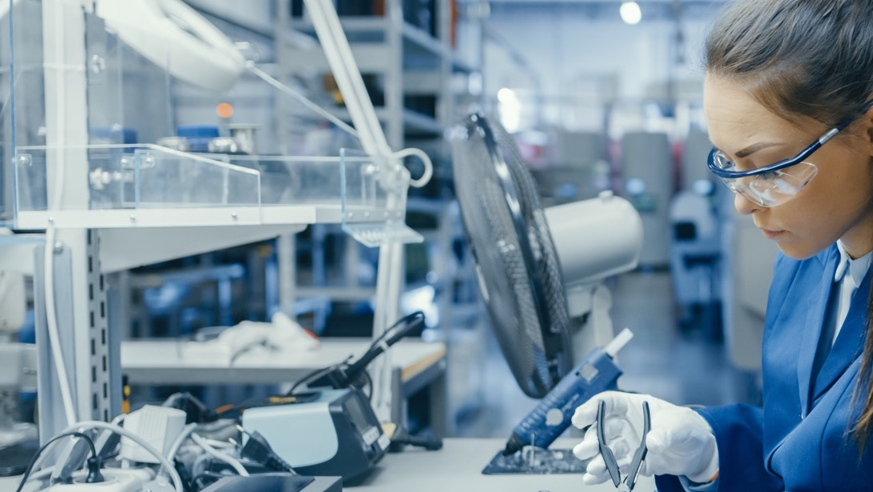

Global & European key plastics production data and trends
2024 data
Notes:
With plastics being traded on a global market, I would like to start off by zooming out, meaning we will begin by looking at the latest developments in global plastics production before focusing on Europe.

Slide 6
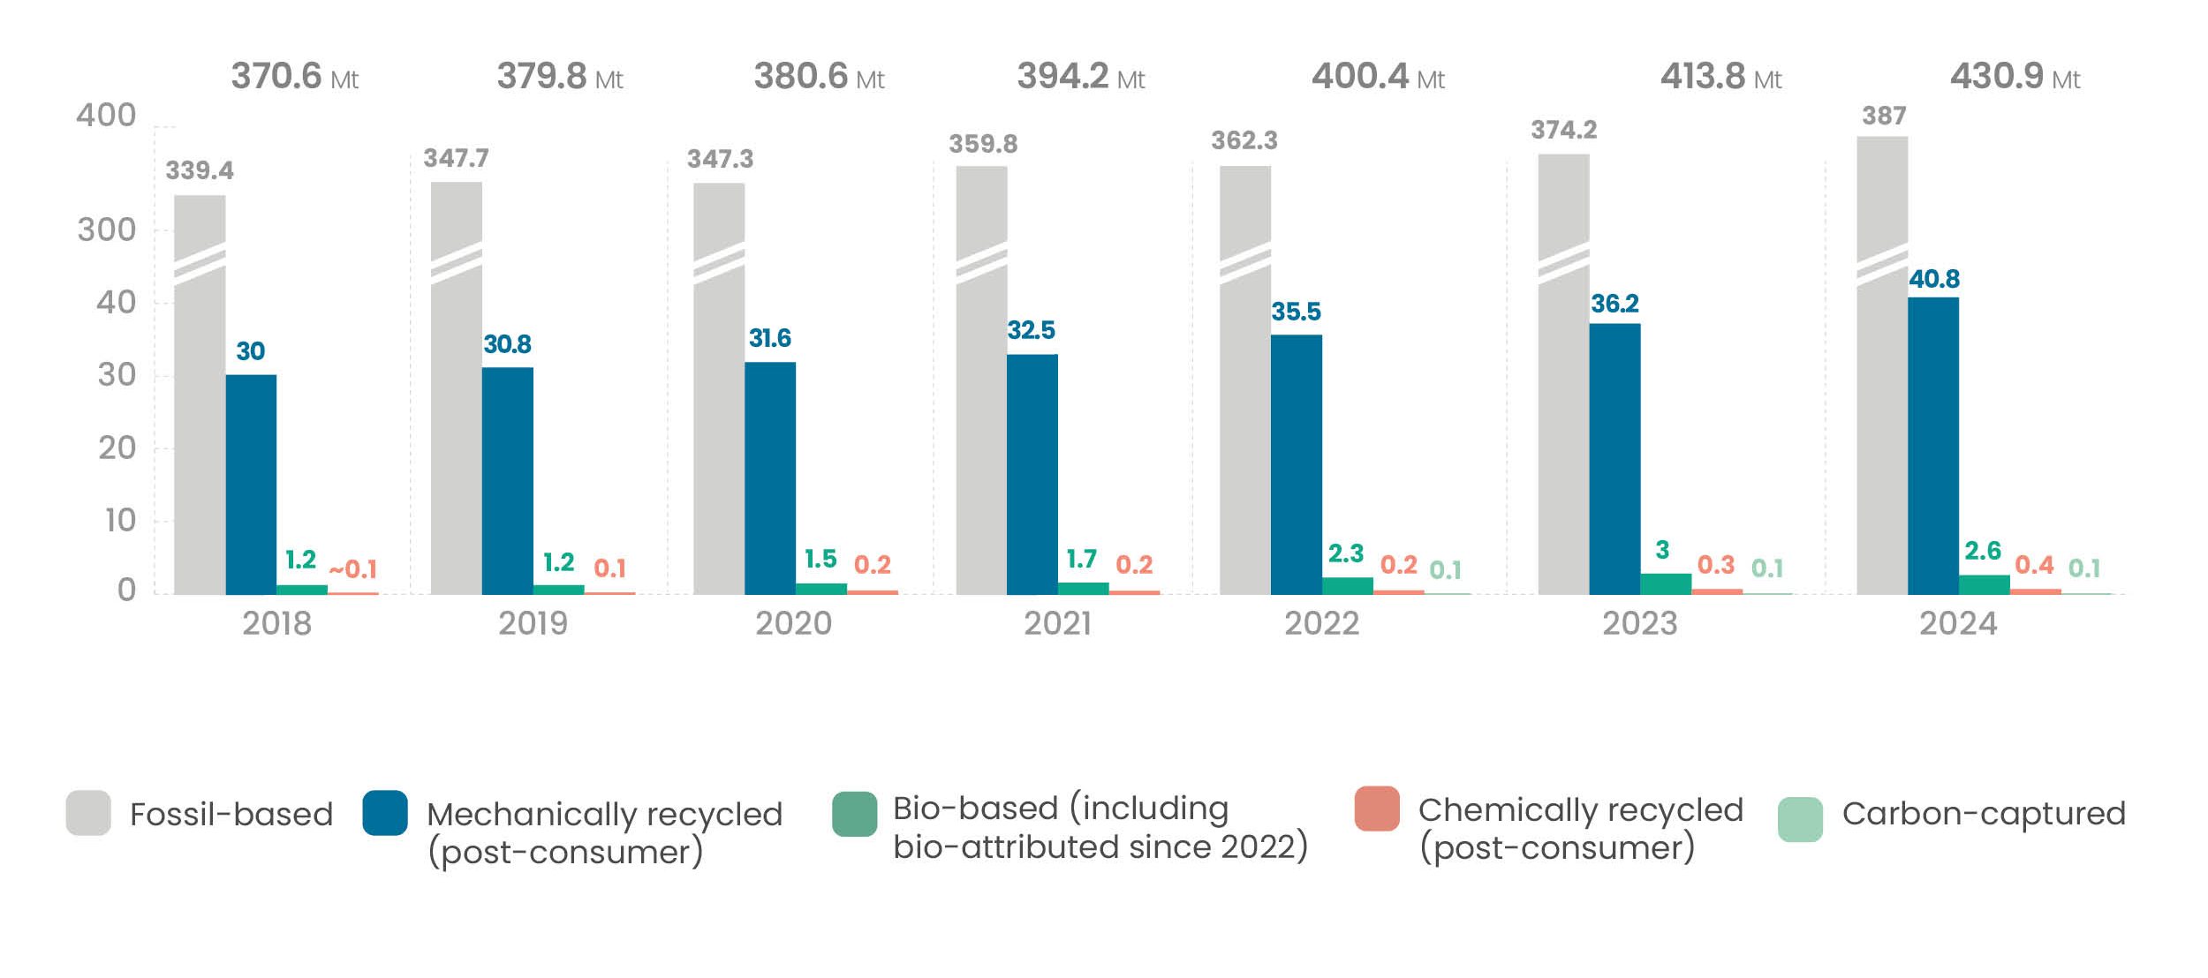
Global plastics production grows steadily
Global plastics production
2018-2024 evolution
Production growth of more than 16% compared to 2018
Total annual growth of more than 4% per year
Mechanically recycled plastics production: +12.7%
Source: “Plastics the Fast Facts 2025” - © Plastics Europe
Notes:
Looking at global production, what we can observe is that the overall quantity of plastics production continues to increase at a steady pace, reaching over 430 million tonnes in 2024.
Overall, we see an increase of 16.2% compared to 2018, indicating a consistent upward trend.
The annual growth rate slightly exceeds 4%, which is higher compared to the annual growth we have seen in the recent years (always between 1.5-3.5%).
What the new figures also show, is that fossil-based plastics still dominate, but mechanically recycled plastics are gaining ground, far above bio-based and chemically recycled plastics.
Especially mechanically recycled plastics production increased by 12.7%, in just one year, going from 36 million tonnes in 2023 to almost 41 million tonnes in 2024.

Slide 7
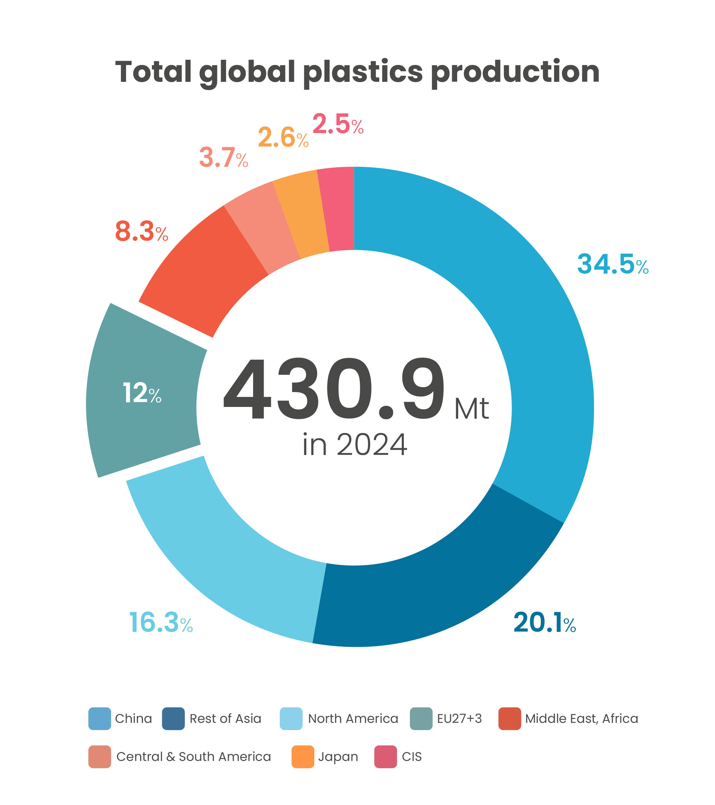
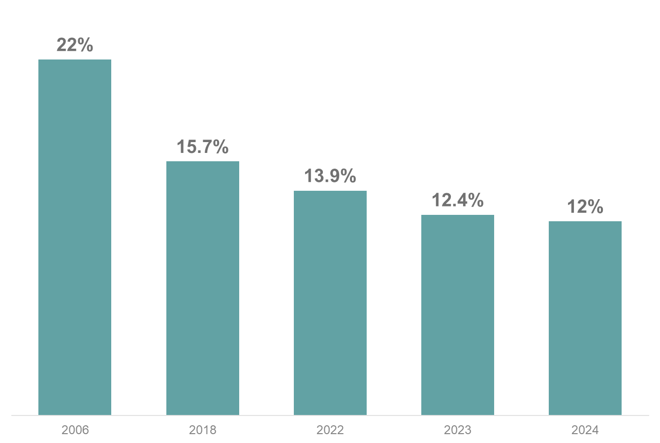
Continuous erosion of Europe’s global market share
Source: “Plastics the Fast Facts 2025” - © Plastics Europe
Notes:
Looking deeper into the regional developments of the global plastics production, we see that
China and Rest of Asia account for more than 55% of the production
Followed by North America, with a bit more than 16%, which means that North America lost market share form 17.1% in 2023 (17% in 2022, 18% in 2021, 23.5% in 2006)
Europe comes forth, with a further decrease in its market share, hitting 12% (a figure that has almost halved since 2006).
This figure does not come as a surprise to us but rather confirms what we already knew. Unfortunately, Europe’s global competitiveness continues to decline.
Our share of world plastics production has been eroding year after year, and this trend is a serious threat to the future of European manufacturing.

Slide 8
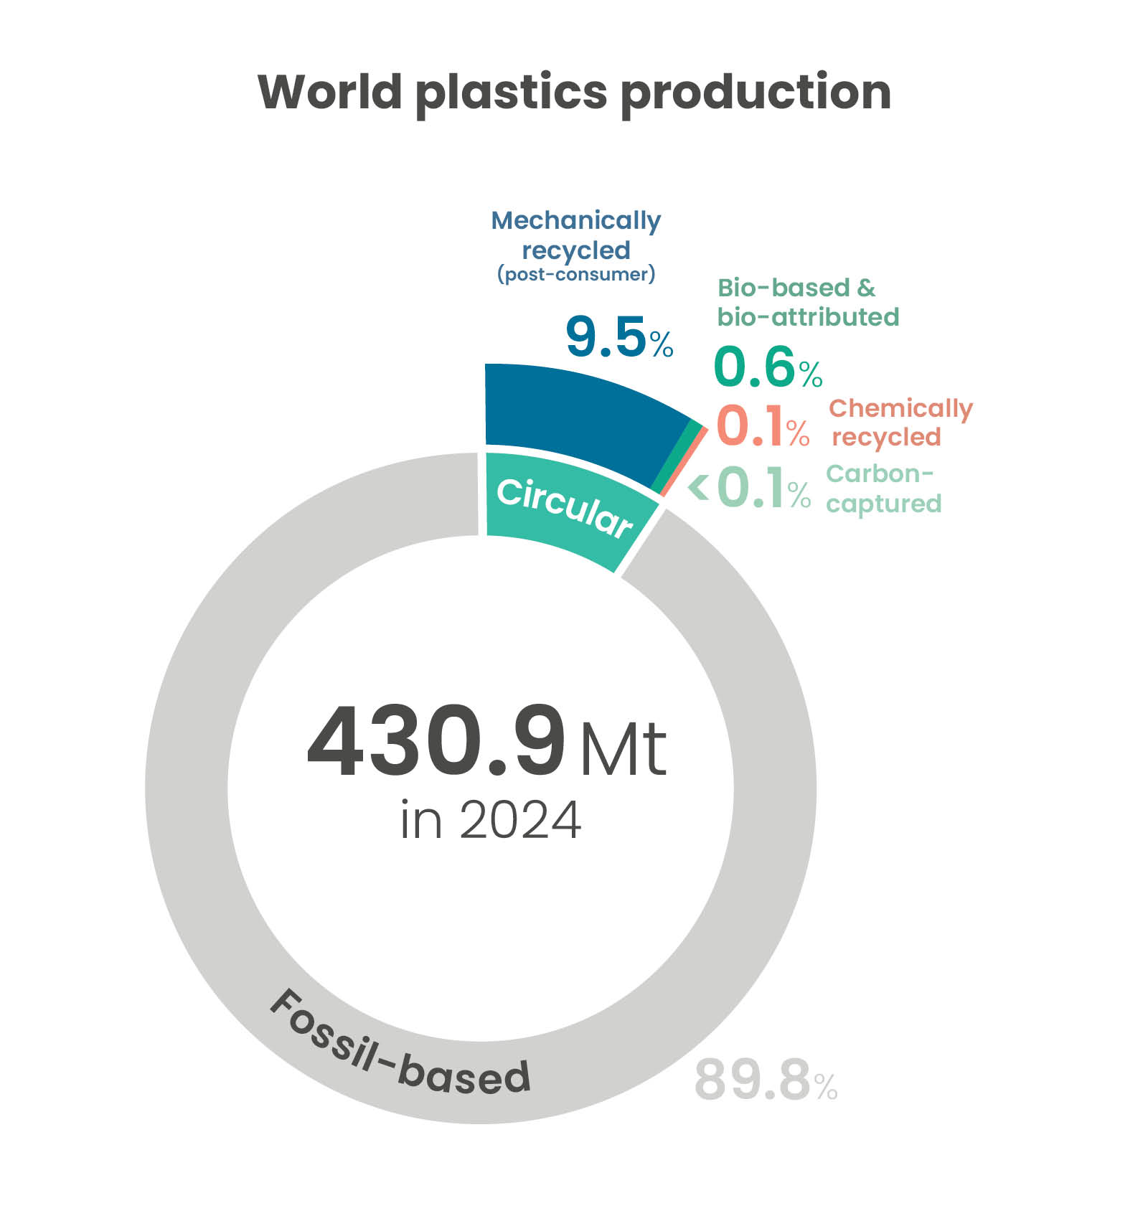
Share of circular plastics production increases
For the first time circular plastics account for more than 10% of the global plastics production
Increase driven by China’s recycling production growth
Source: “Plastics the Fast Facts 2025” - © Plastics Europe
Notes:
For a transition to a Circular Economy, not the production volume itself is of interest but rather the development of circular plastics production.
Note that circular plastics are those produced with non-fossil feedstocks, such as mechanically and chemically recycled plastics, bio-based plastics and those produced via carbon capture and utilisation (CCU).
We can see that the share of “circular plastics" has gone up to 10.2%.
This data point is particularly interesting because, for the first time, circular plastics account for more than 10% of global production.
Unfortunately, Europe cannot take credit for this important milestone.
This growth is driven mainly by a strong surge in recycling in China. On the next slide, I would like to give a bit more detail on that development.

Slide 9
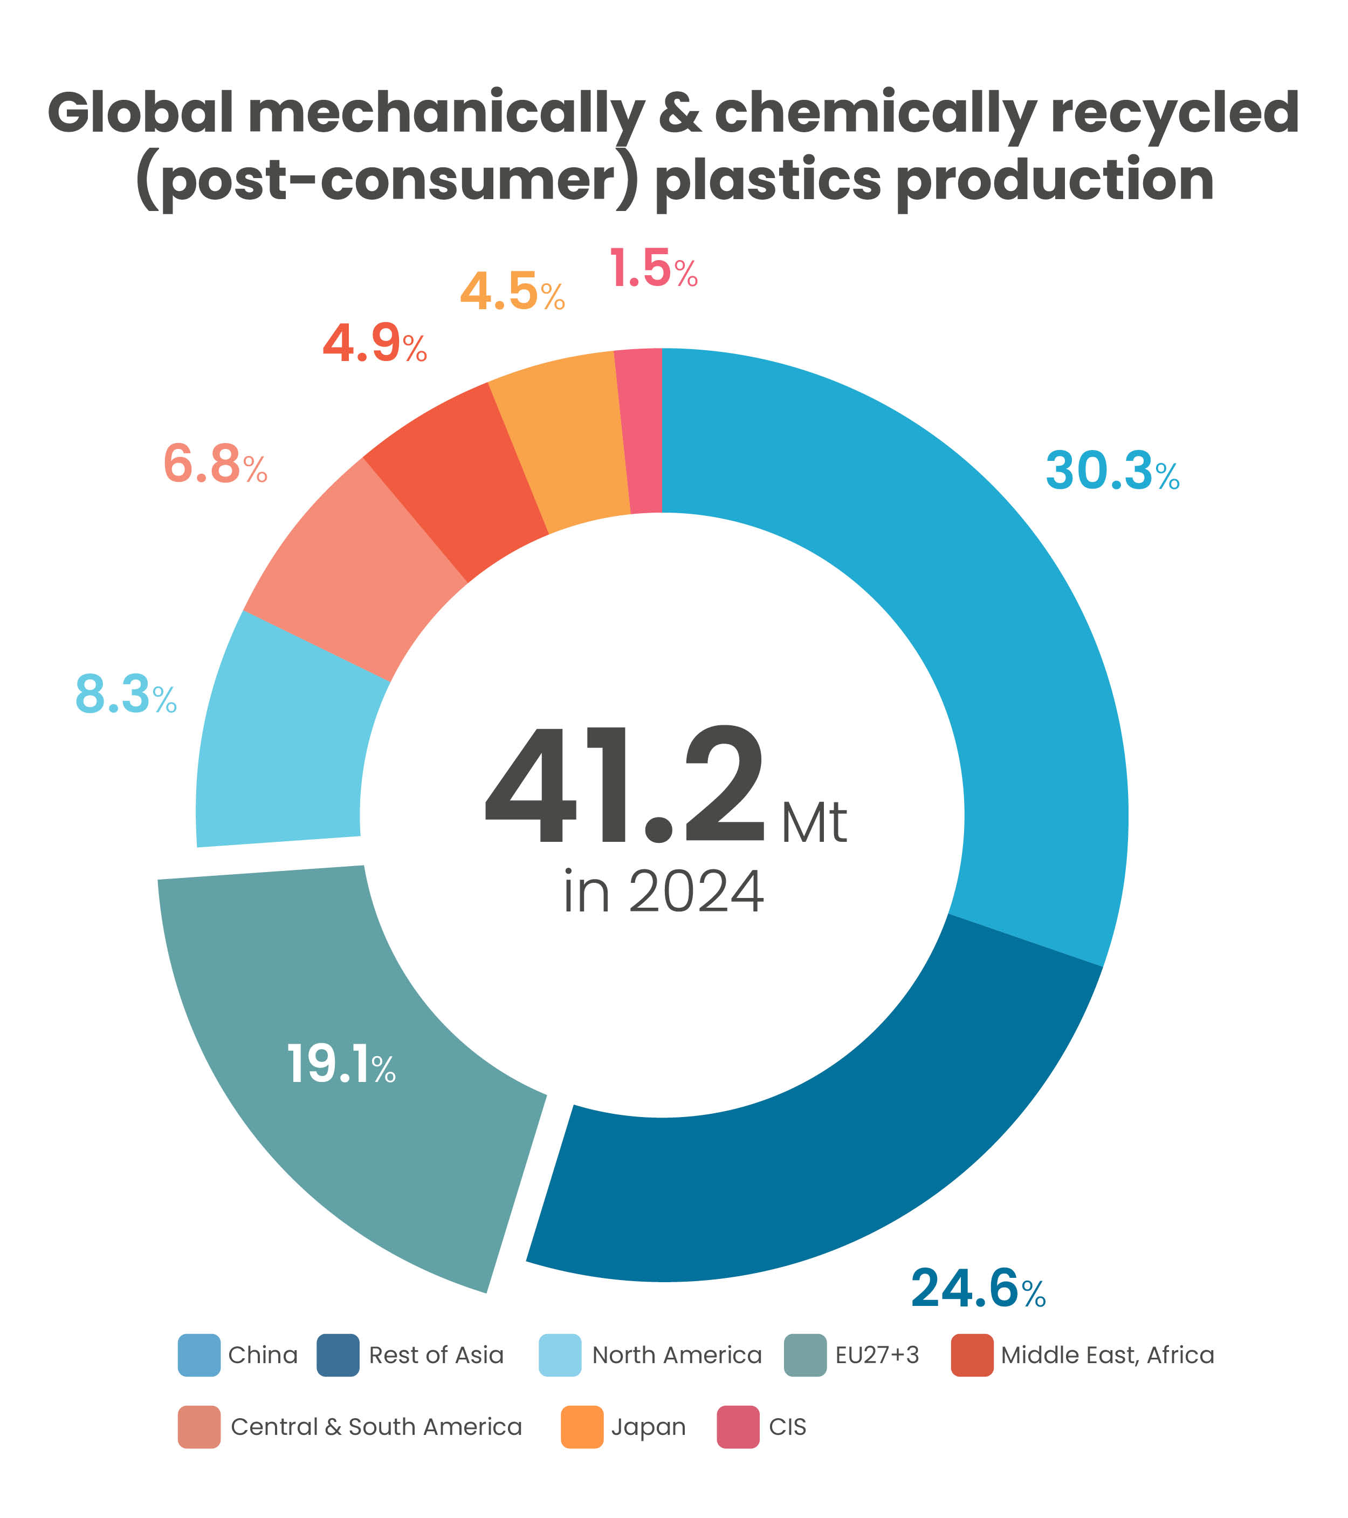
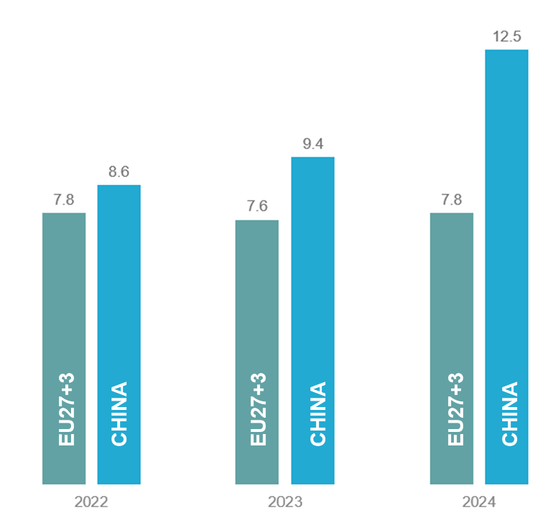
China leads global recycled plastics production
Global recycled plastics production:
+16% in 2 years, mainly impulse by China's growth of +45%
Recycled plastics production
(in Mt)
Source: “Plastics the Fast Facts 2025” - © Plastics Europe
Notes:
The graph on the left zooms in further into the distribution of mechanically and chemically recycled plastics production by regions of the world. Overall, the recycled plastics production has gone up by 16.2% in just 2 years.
China is clearly in the lead and, together with Rest of Asia, is widening the leadership margin.
On the right, a stark contrast is evident between China and Europe. Looking at the data for 2022- 2024, we see that while Europe's production of recycled plastics has stalled, China's production has increased by 45% in only two years, reaching 12.5 million tonnes.
This situation is unfortunately one that we expect to continue, as per the constant announcements of new recycling investments in China (including chemical recycling production) and disinvestments and plant closures in Europe.

Slide 10
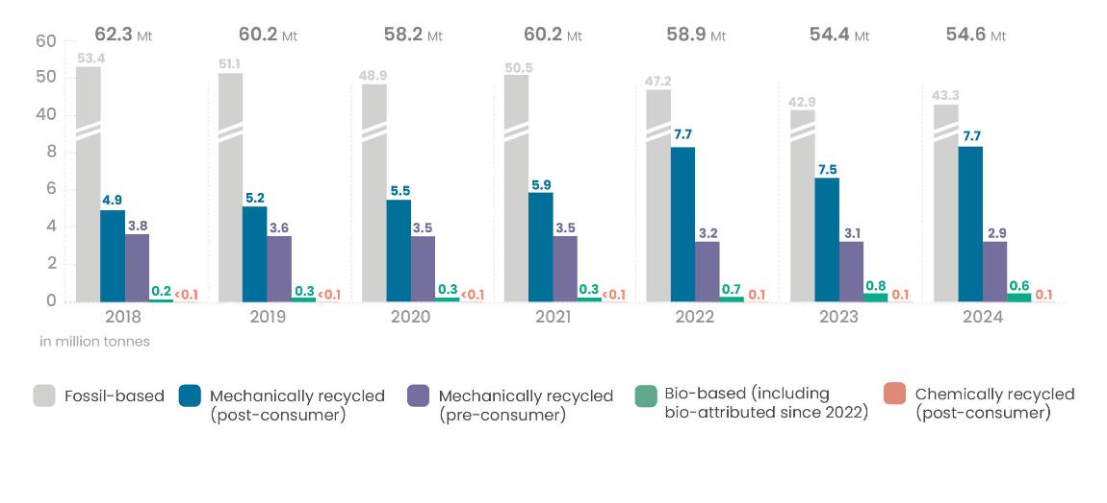
Europe’s plastics production continues at lowest levels since two decades
European plastics production
2018-2024 evolution
European total production modestly stabilises (+0.4% vs. 2023)
Circular plastics production remains flat
Bio-based plastics production falls by 25%
Overall production decline of –12.4% since 2018
Source: “Plastics the Fast Facts 2025” - © Plastics Europe
Notes:
Moving from the global perspective into Europe, we will first zoom into the overview of European production which shows a very different picture:
First, we observe a modest stabilisation of overall production with a symbolic growth of 0.4%, after the massive dip in 2023.
This stabilisation is nevertheless in the context of an overall production decline of –12.4% since 2018
For circular plastics production, we have
Mechanically recycled plastics production grows 2.7%, returning to 2022 levels
Chemically recycled plastics production remains static. Again, no surprises here due to a lack of clear regulatory signals for investments
Bio-based including bio-attributed plastics production declines by 25% primarily due to a decrease in bio-attributed plastics production.

Slide 11
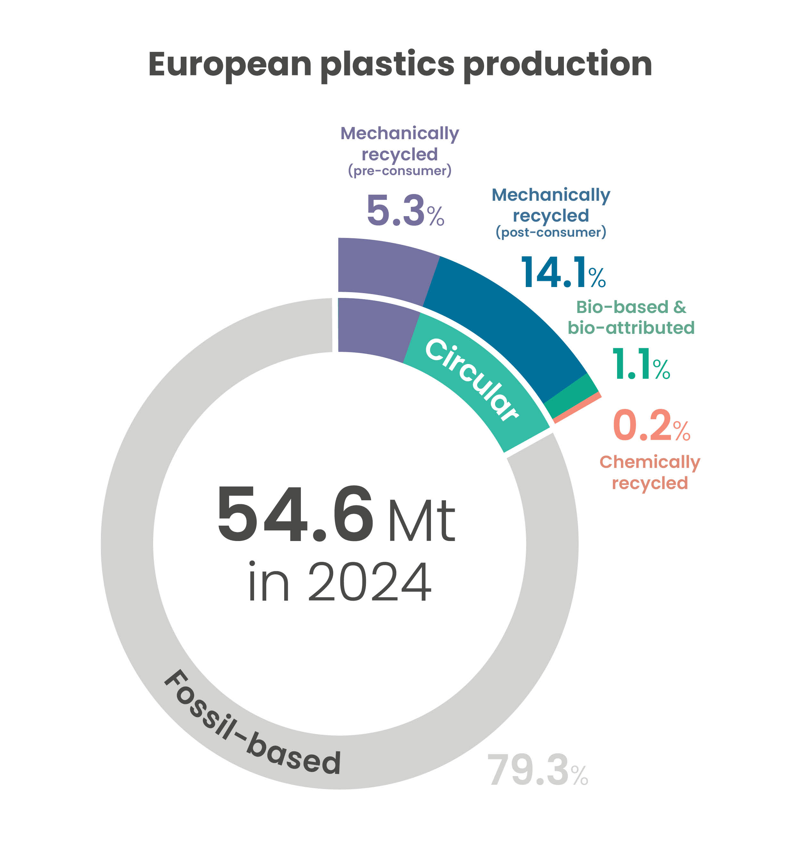
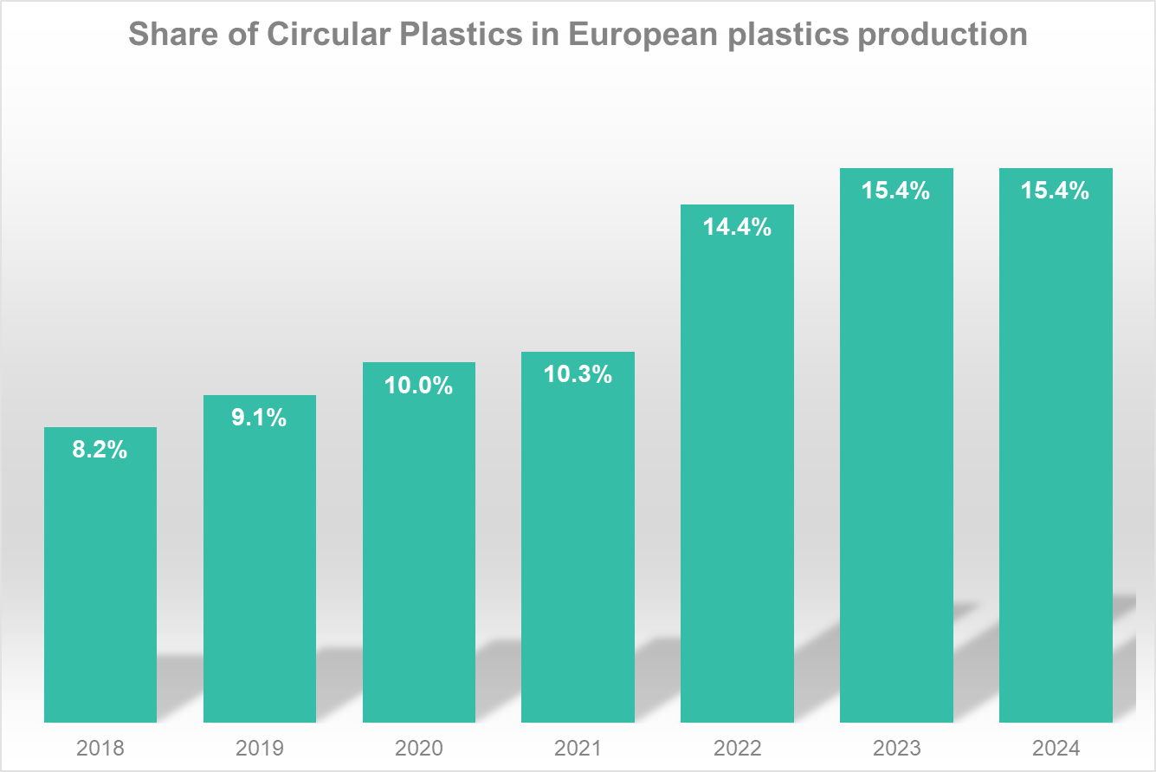
Europe’s share of circular plastics stagnates
8.4 Mt of circular plastics in 2024
Source: “Plastics the Fast Facts 2025” - © Plastics Europe
Notes:
As we saw already from the previous slide, there is a worrying stagnation in Europe’s circular plastics production.
In 2024, the total amount of circular plastics produced in Europe reached 8.4 Mt, a quantity that has not progressed for the last three years.
Here on the left, we see the share of circular plastics (a total of 15.4%) in relation to the overall European plastics production of 54.6 million tonnes in 2024. And to the right, a graph showing the evolution of the share of circular plastics, which, as we see, is exactly the same in 2024 as it was in 2023.
While circular plastics accounted for 15.4% of EU production in 2024, this figure reflects a sharp 18.9% decline in fossil-based production since 2018, rather than a significant expansion in circular production.

Slide 12

2024 European key economic indicators
Notes:
Moving on from production, we will now look at some economic indicators for the European plastics sector.
Our analysis of key economic indicators across the entire plastics value chain revealed numerous negative developments. However, we will be presenting figures related to plastics manufacturers, recyclers, converters, and machinery producers.

Slide 13




EU plastics industry economic indicators confirm decline
~50,650
companies
~1.5 M
employees
~ €398 bn
turnover
Business closures
Job losses
Sharp decline in turnover
~3,000 companies have stopped operating since 2022
~35,000 people
have lost their employment since 2022
-13% compared to 2022
Notes:
In 2024, the European plastics sector remained a strategic industrial asset, with approximately 1.5 million employees spread across 50,650 companies.
However, when you compare these figures to those of previous years, they reveal a sector in rapid decline.
Looking at the number of companies, for example, we estimate that around 3,000 companies have closed since 2022.
This has resulted in about 35 thousand people in our industry having lost their jobs in that same period.
In terms of turnover, the sector has experienced a sharp decline of 13% in just two years, going from €457 in 2022 to €398 billion in 2024.

Slide 14

Trade data and trends
Notes:
As geopolitical tensions rise, we will look at some selected trade figures.

Slide 15
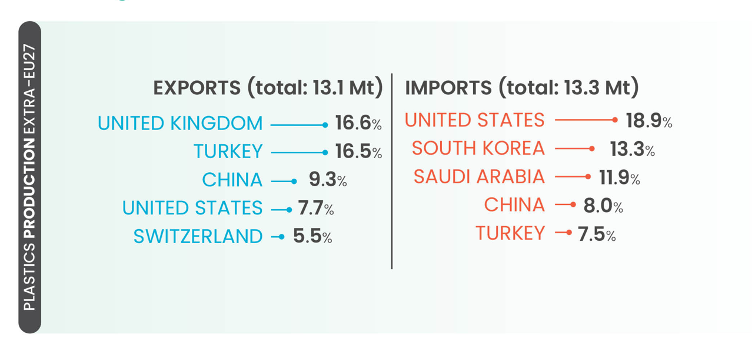
EU trade data confirms competitiveness challenges
Negative trade balance in tonnes for
EU27 Plastics raw materials -0.2 t
EU27 Plastics products -1.4 t
EU as net importer of plastics, three years in a row
United States largest source of imports of plastics, and 4th export market for the EU
Source: “Plastics the Fast Facts 2025” - © Plastics Europe
Notes:
Although the trade balance in value is still positive, the latest developments show that in terms of volume, our trade balance is negative –1.6Mt tonnes,
and for the 3rd year in a row, the European Union is a net importer of plastics.
Also worth highlighting here is that the United States is the largest source of imports of plastics in primary form into Europe, accounting for almost 19% of the market,
and the fourth largest export market for EU plastics, accounting for 7.7% of the market.
A situation that may further evolve with the changing global tariff regimes, which continue to pose a significant threat to our European industry.

Slide 16
2024 key trends in a nutshell
Global production
EU27+3 production
EU indicators & trade
GROWTH
STAGNATION
DECREASE
Notes:
And now to wrap up what we have seen so far. Plastics the Fast Facts 2025 shows:
Global growth of plastics production, a stagnation of production in Europe including circular plastics production and a decrease in the EU economic indicators
[KS to handover to VJ again]

Slide 17

Industry outlook
Notes:
[VJ is back on the podium]
Thank you, Katharina.

Slide 18

It’s not too late to turn the tide
Time is running out, but with urgent policy support we can:
Build the world's first circular plastics system
Protect the strategic European industries that benefit from a secure local supply of plastics
Source: Canva
Notes:
It’s undeniable that Europe's plastics industry is at the cliff edge.
Survival is the urgent issue facing the EU’s production assets,
which are being dismantled and replaced by modern industrial capacity abroad
at an alarming rate.
Time is running out and the outlook is very concerning.
But there is still a narrow window of opportunity for Europe to regain innovation leadership and build the world’s first circular plastics system.
And protect the strategic European industries that benefit from secure local plastics supply chains
We don’t have to decarbonise through deindustrialisation.

Slide 19
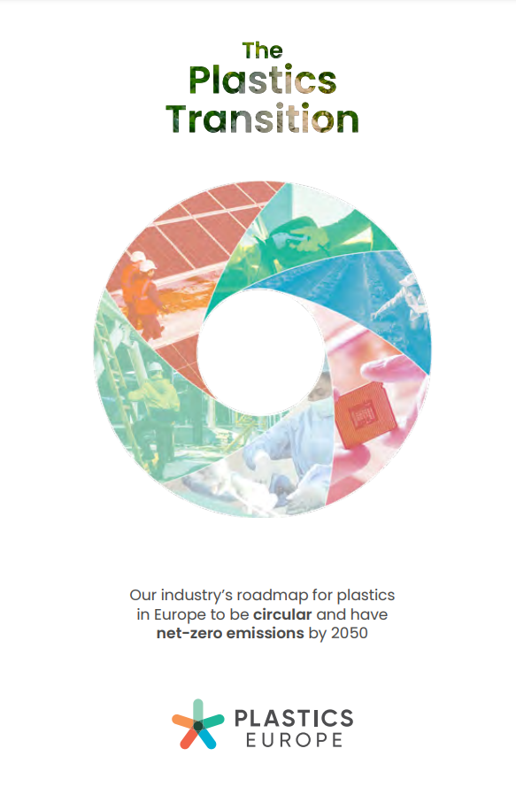
Plastics Europe has a vision for a sustainable plastics system
Our North Star
25%
Circularity
by 2030
65%
Circularity by 2050
28%
Reduction GHG emissions by 2030
Net Zero
emissions
by 2050
Notes:
We have our Plastics Transition roadmap that can help turn the tide. Because at Plastics Europe, we have a clear vision by 2050:
A Europe that uses 65% circular plastics
A Europe with a net-zero emissions plastics system.
A Europe with strategic autonomy, including production using plastic waste as our local feedstock here at home - supplying our electronics, housing, renewable energy, defence - and many more critical sectors.
We can do all of this, but we need urgent support.

Slide 20
How EU and national policymakers can help
Tackle Europe's energy cost crisis
Strengthen the enforcement of EU legislation at its borders
Boost European circular plastic production and remove internal barriers
Establishing a Chemicals and Plastics Trade Observatory
Notes:
To stabilise the industry, Plastics Europe is calling for four urgent EU and national actions to restore competitiveness and stimulate investment. By:
Tackle Europe's energy cost crisis: Add chemicals and polymers to the EU ETS compensation list and reinvest revenues into the sector to accelerate circular and net-zero emissions transitions.
Strengthen EU legislation at borders, including on imports: Invest in customs capacities, harmonising controls, using digital tracing tools, and require third-party certification for imports to uphold environmental and labour standards - preventing carbon leakage and unfair competition.
Boost European circular plastics production and remove internal barriers: Encourage investment and market demand with ambitious recycled-content targets, incentives, and by removing internal barriers for the free flow of goods and secondary raw materials.
Establish a Chemicals and Plastics Trade Observatory: Monitor trade flows in real time and deploy fair trade measures and support tools to protect the EU industry from unfair practices and irreversible impacts.

Slide 21

“
Only a competitive European plastics sector today will unlock the market drivers and investments required for our much-needed circular economy of tomorrow.
”
21
Notes:
I would like to close by reminding everyone that plastics are and will remain an essential material that underpins European industrial resilience, innovation and competitiveness.
Keeping a sufficient level of local production avoids excessive dependence and strengthens Europe’s security.
Only a competitive European plastics sector today will unlock the market drivers and investments required for our much-needed circular economy of tomorrow.
Thank you.

Slide 22
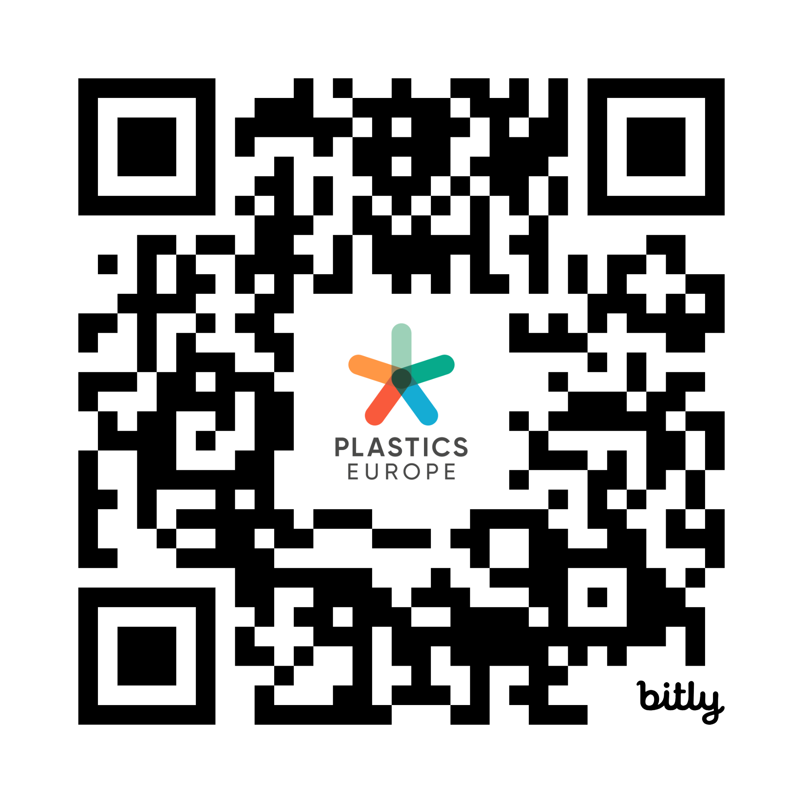
Q&A session
Access the full media kit here
Notes:
[Sylvie back on stage]
Thank you, Virginia and Katharina.
We’ll now open the Q&A session.
For those here in the room, please raise your hand – a microphone will be brought to you.
Kindly state your name and organisation before your question.
We’re also monitoring questions from our online channels, and we’ll bring a few of those in as time allows.
Let’s get started.

Slide 23
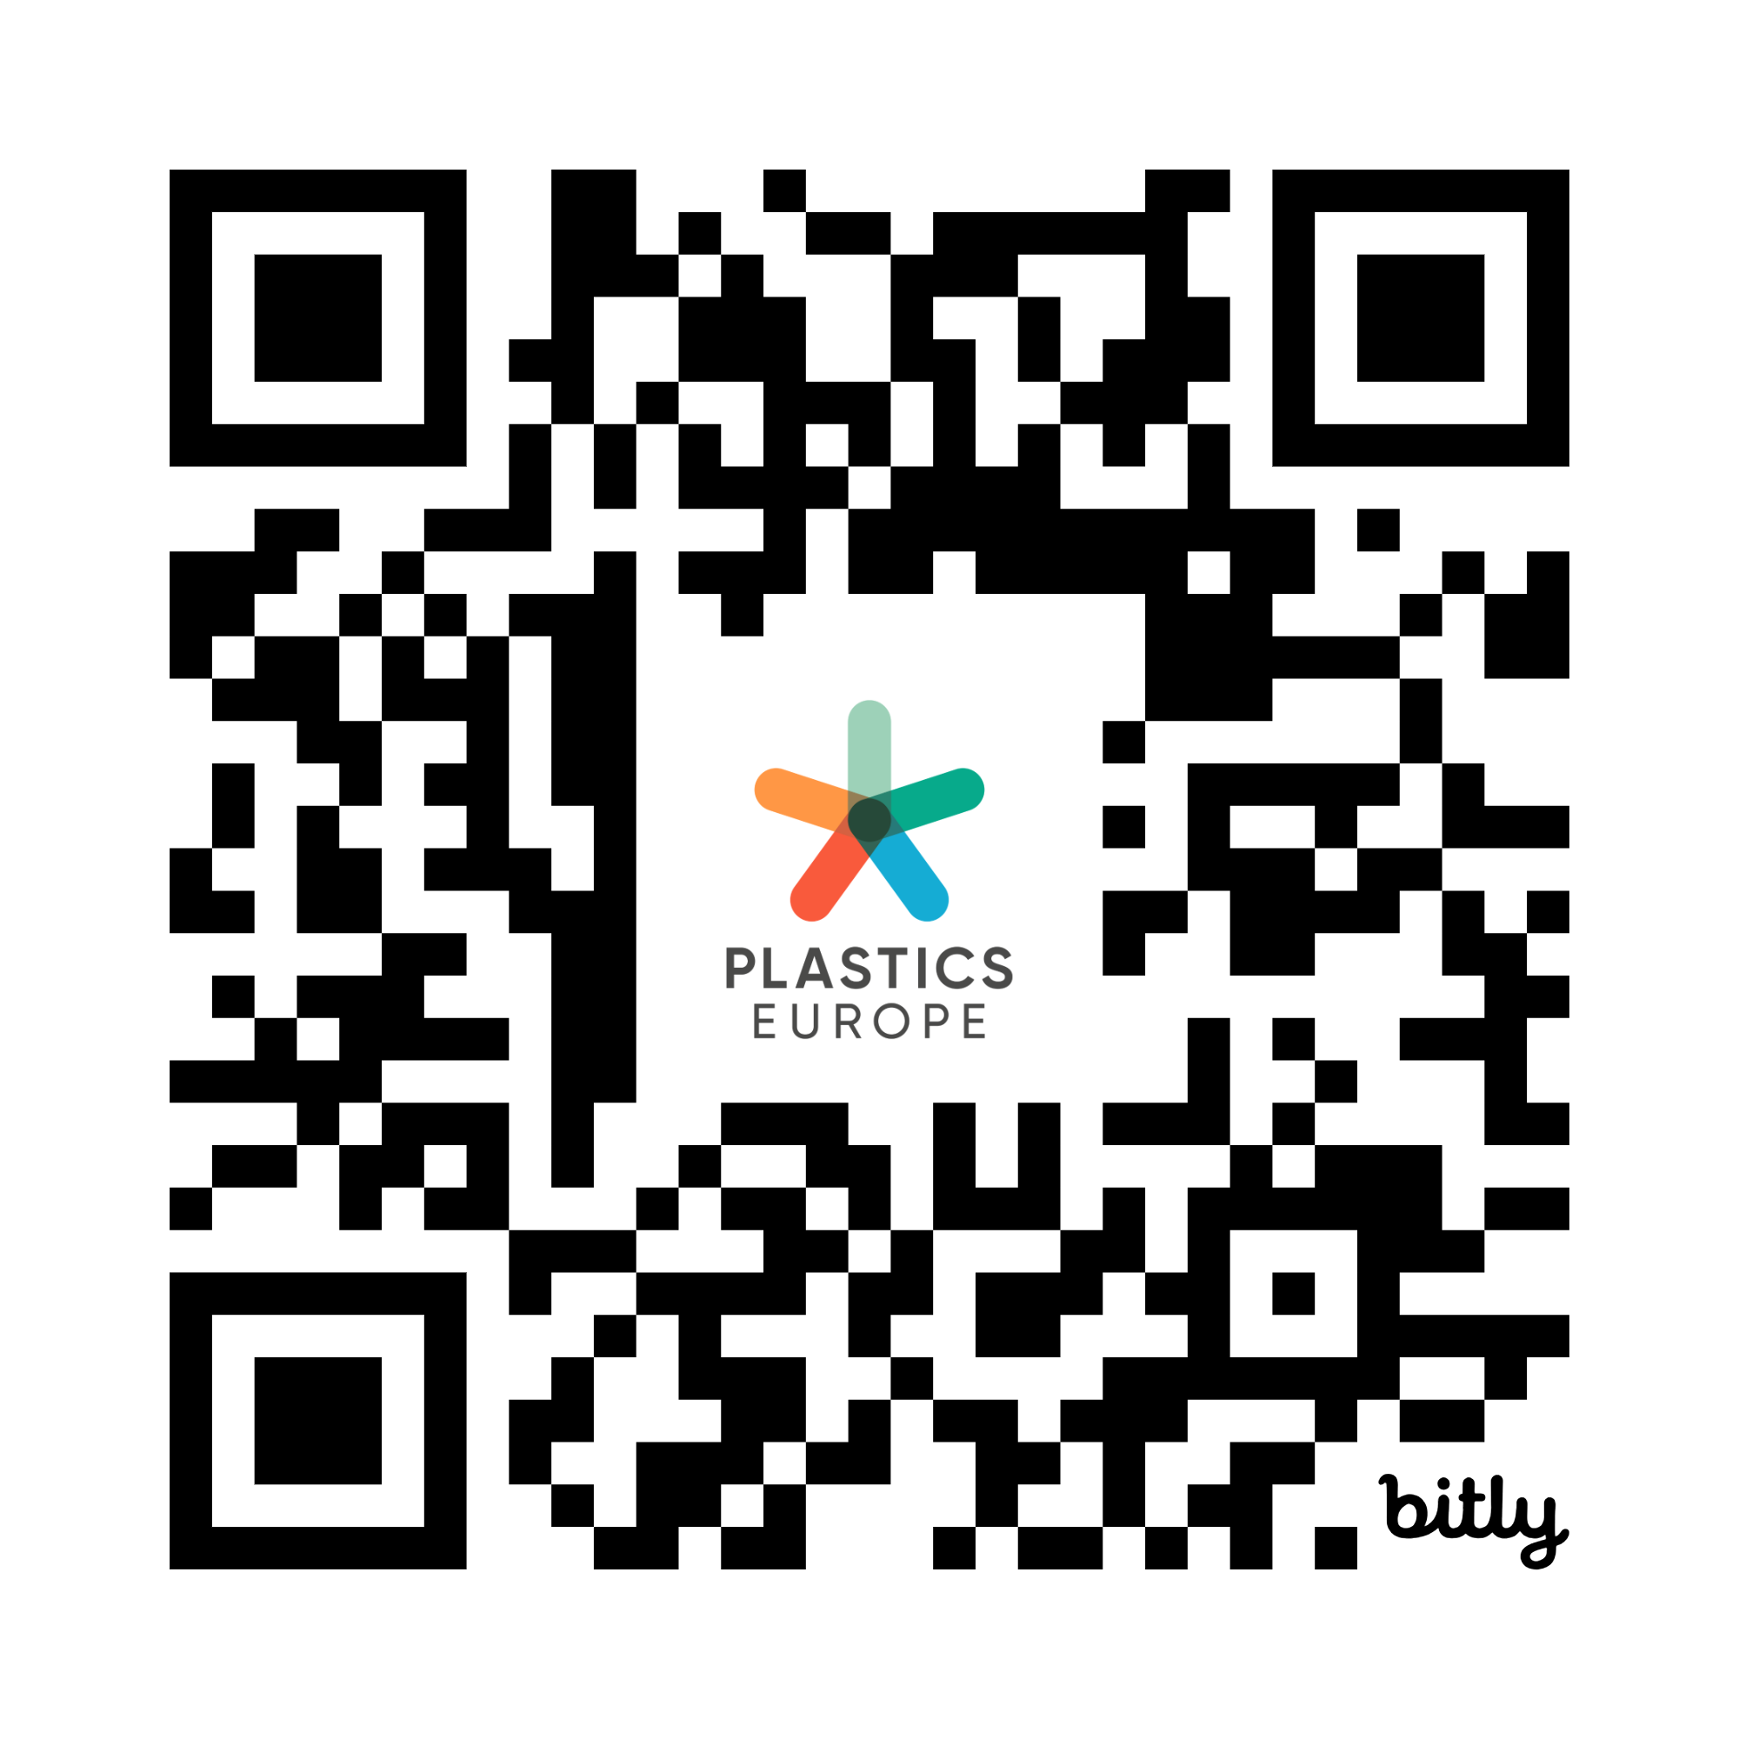
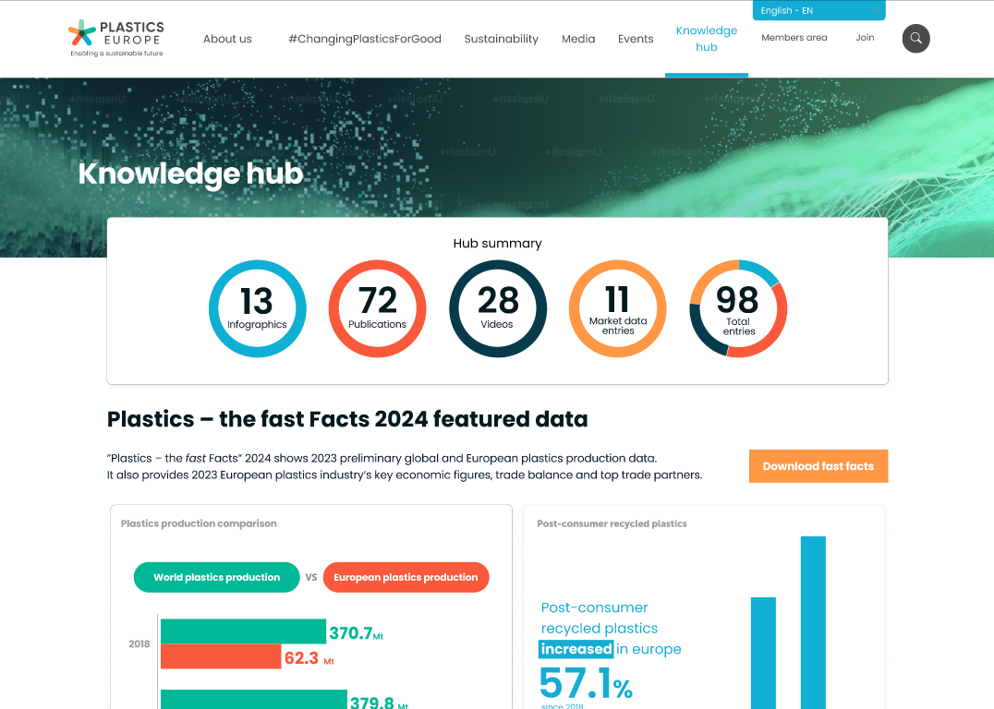
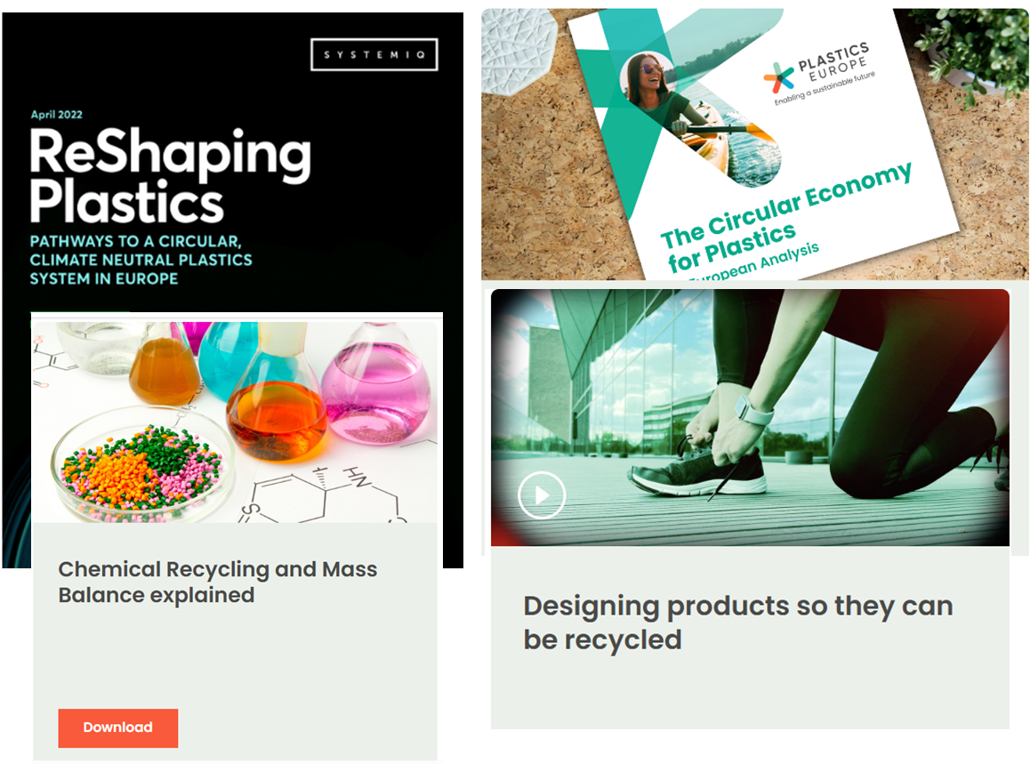
Hungry for more data? Check out our brand new data hub
Notes:
[After Q&A, Sylvie thanks the audience and speakers; the promotes the data hub]
Thank you all for your insightful questions and for being part of today’s discussion.
But before we close, I’m especially excited to announce the launch of our brand new Plastics Europe Data Hub
a centralised digital repository providing access to an extensive range of Plastics Europe’s data resources.
Simply scan the QR code on screen

Slide 24
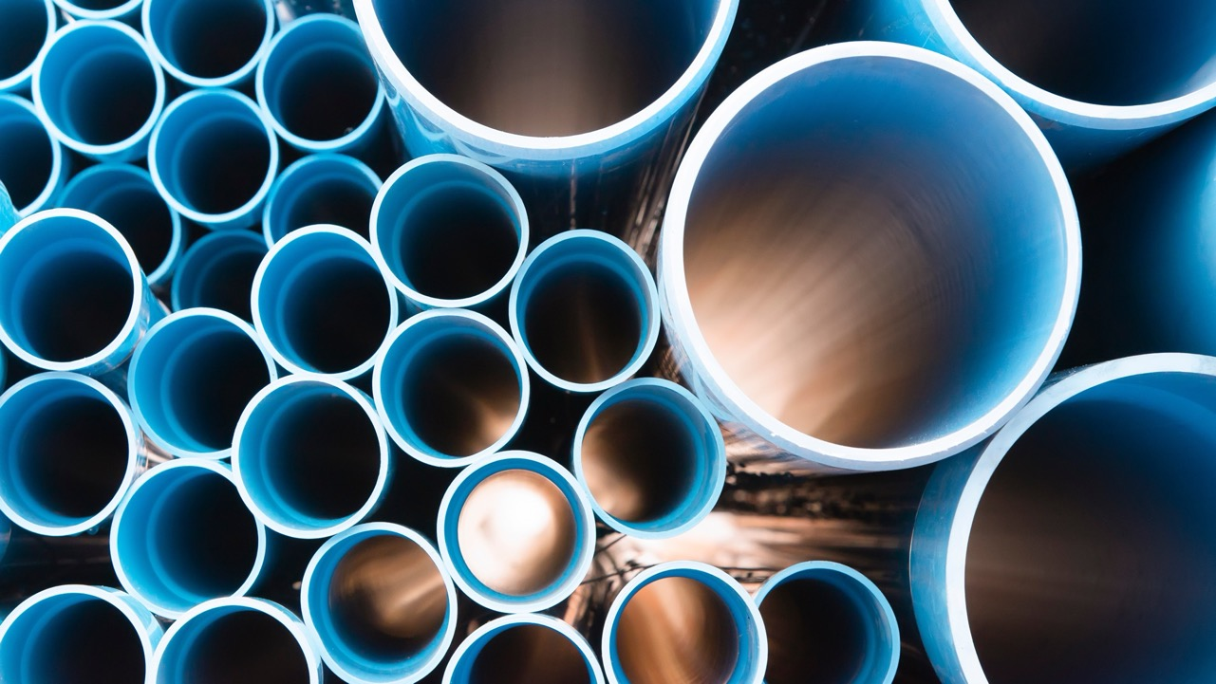

Thank you
@PlasticsEurope
Plastics Europe
plasticseurope.org
#ChangingPlasticsForGood
Notes:
And now to wrap up:
For any follow-up queries, please reach out to our Senior Media Manager, Cecilia Koshiikene – Cecilia, please give us a wave.
You can also continue the conversation with us on LinkedIn.
Finally, don’t miss our next session at 3 o’clock, where Virginia will moderate a panel discussion on “Accelerating the Plastics Transition Through Innovation.”
Thank you all for joining us – both in person and online – and enjoy the rest of K 2025!
Finally, don’t miss our next session at 3 o’clock, where Virginia will moderate a panel discussion on “Accelerating the Plastics Transition Through Innovation.”

